Slide 1
Battle of the neighborhoods
Cape Town VS Johannesburg – South Africa
Ebrahim Dawood
Senior Data Analyst

Slide 2
PROBLEM
When thinking about relocating to a new city or country for work purposes or to start a new life, people tend to research areas before moving. This research includes population rate, average house price, school ratings, crime rates, weather conditions, recreational facilities etc.
Based on the above, a search engine algorithm would be an efficient tool to use that will allow users to enter cities and get the neighborhood name that best suits their lifestyle or living conditions. This could be done using an algorithm that will perform an extensive analysis on the similarities and dissimilarities between neighborhoods in the two cities of the user’s search criteria, and determine which neighborhoods best suits their lifestyle

Slide 3
OBJECTIVE
Collect the suburbs top venues using Foursquare
Form suburb clusters based on venue categories using unsupervised k-means clustering algorithm
Identify and understand the similarities and differences between Johannesburg and Cape Town suburbs to obtain insights into the suburbs

Slide 4
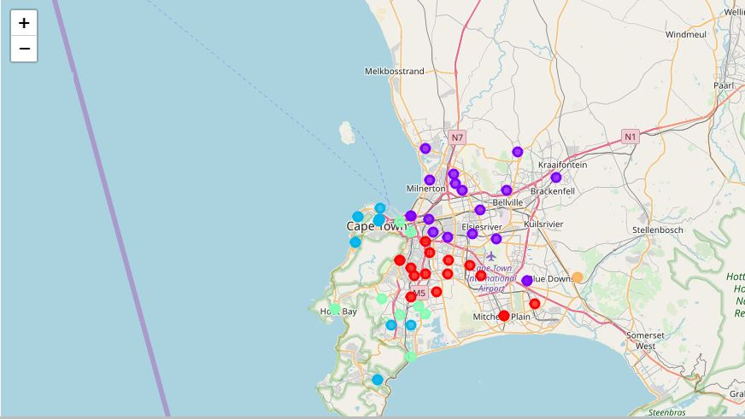
Cape Town
Cluster 1
17 Suburbs
Common Venus include Coffee Shops, Restuarants, Nightclubs and Hotels
Cluster 2
22 Suburbs
Common Venues include Bookstores, Coffee Shops, Convenience Stores and Restaurants
Cluster 3
29 Suburbs
Common Venues include Hotels, Pubs, Accessory Stores and Coffee Shops
Cluster 4
10 Suburbs
Common Venues include Fast Food Restaurants, Winery, Beaches and Cafes
Cluster 5
2 Suburbs
No common venues found

Slide 5
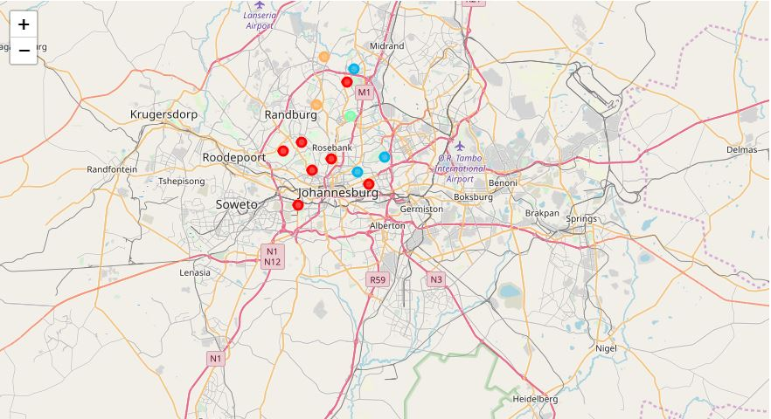
Johannesburg
Cluster 1
30 Suburbs
Common Venues include Hotels, Spas, Parks and Coffee Shops
Cluster 2
24 Suburbs
Common Venue is Hotels
Cluster 3
28 Suburbs
Common Venues include Hotels, Turkish Restaurants and Gyms
Cluster 4
21 Suburbs
Common Venues include Hotels, Greek Restaurants, and Food and Drink Shops
Cluster 5
16 Suburbs
Common Venues include Hotels, Shopping Malls and Steakhouse

Slide 6
Cape town vs johannesburg
Cape Town has 83 suburbs with 675 venues. In addition, the geographical coordinate of Cape Town, South Africa is -33.928992, 18.417396. The best suburb to stay in is Durbanville with the following venues:
1st Most Common Venue Café
2nd Most Common Venue Gym
3rd Most Common Venue Thai Restaurant
4th Most Common Venue Pub
5th Most Common Venue Breakfast Spot
6th Most Common Venue Coffee Shop
7th Most Common Venue Fast Food Restaurant
8th Most Common Venue Steakhouse
9th Most Common Venue Grocery Store
10th Most Common Venue American Restaurant
Johannesburg has 119 suburbs with 198 venues. In addition, the geographical coordinate of Johannesburg, South Africa is -26.205, 28.049722. The best suburb to stay in is Bergvlei with the following venues:
1st Most Common Venue Hotel
2nd Most Common Venue Turkish Restaurant
3rd Most Common Venue Gym
4th Most Common Venue Greek Restaurant
5th Most Common Venue Golf Course
6th Most Common Venue French Restaurant
7th Most Common Venue Food & Drink Shop
8th Most Common Venue Exhibit
9th Most Common Venue Deli / Bodega
10th Most Common Venue Convenience Store
Many of the neighborhoods are homogenous and are very similar to each other. Both Johannesburg and Cape Town consist of suburb clusters that contain majority of the suburbs.

Slide 7
CONLCUSION
Cape Town had a significant more number of suburbs and venues than Johannesburg therefore it would be the better option to relocate to Cape Town, specifically Durbanville as the most efficient choice. Cape Town offers a variety in choices for restaurants, gyms, grocery stores, and extracurricular activities for individuals and families.

